Slide 1
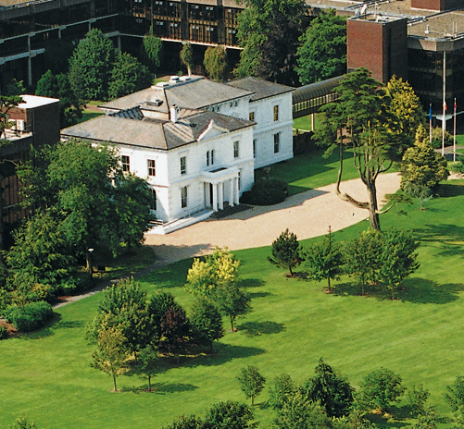


PROJECT MANAGEMENT IN PRACTICE
Project Time Management
Lecture No: 6 Week: 3
Vispi Shroff
Sub Heading
And Date

Slide 2

Recap
Importance of good project scope management
Methods of collection and documentation of requirements
Scope definition process
Contents of a project scope statement
Creating a work breakdown structure (WBS)
Different methods for creation
Importance of verifying scope
Controlling scope; avoiding scope creep

Slide 3
Today’s Topics & Learning Outcomes
Importance of project schedules and good time management
Activity/Task Definition
Task Sequencing using diagrams and Dependencies
Next Time Management Lecture
Resource Estimation and Project Schedule
Optimisation Techniques
Critical Path Analysis
PERT (Program Evaluation and Review Technique)
Schedule Control

Slide 4
Importance of Project Schedules
Time on projects tend to be the least flexible constraint.
Schedule is the main reason for conflicts
Delivering projects on time is cited as one of the biggest challenges by managers
Causes of Conflicts
Incorrect estimation to begin with
Lack of change control
Lack of planning
Myers-Briggs Type Indicator (J vs P)
Cultural Differences

Slide 5
Project Time Management
Define Activities
Sequence Activities
Estimate Activity Resources
Controlling the Schedule
Estimate Activity Durations
Develop Schedule

Slide 6
Define Activities
Derived from your WBS.
Decompose to the level of detail required
Activity Lists – Name, ID, Description
Activity Attributes – Predecessors, Successors, Logical Relationships, constraints, imposed dates, assumptions.
Milestones – Significant event, useful for goal-setting and monitoring progress.

Slide 7
Sequencing Activities
Review Activities to determine dependencies and relationships.
Review an activity to determine what other activities it is dependent upon, if any, for it to begin.
Review an activity to determine what other activities it is dependent upon, if any, for it to finish.
You must determine dependencies to use Critical Path Analysis
Use network diagrams to map these dependencies.
It is a “schematic display of logical relationships among, or sequencing of, project activities.
Two forms – Arrow and Precedence Diagramming methods

Slide 8
Types of Dependencies
Mandatory dependencies (hard logic): inherent in the nature of the work being performed on a project.
Discretionary dependencies (soft logic): defined by the project team; sometimes referred to as soft logic and should be used with care since they may limit later scheduling options
External dependencies: involve relationships between project and non-project activities

Slide 9
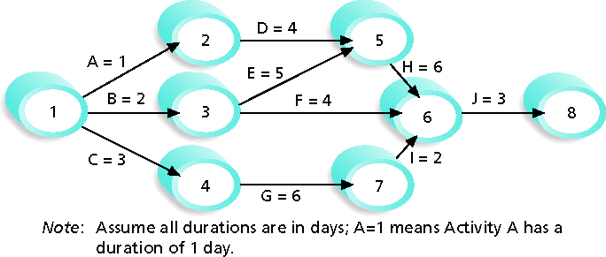
Arrow Diagramming Method
Also known as Activity-on-Arrow (AOA) network diagrams
- Activities represented by arrows, nodes/circles are start and end points, and can only show Finish-to-Start dependencies.

Slide 10
Precedence Diagramming Method
More popular, used by PM software.
-Activities represented by boxes, arrows showing relationships.

Slide 11
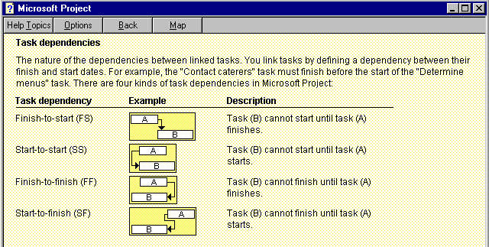
Precedence Diagram

Slide 12
Classroom Activity

Slide 13
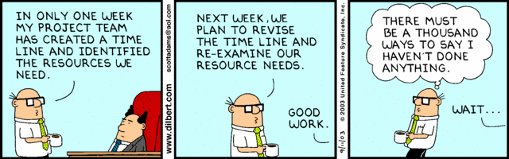
Any Thoughts, Questions, Ideas?
- September 11, 2003

Slide 14
Reading Materials for the Week
Schwalbe, K. – Information Technology Project Management, Chapter 6
PMBOK – Chapter 6
We’ll be looking at
Estimating Resources & Duration
Critical Path Analysis
PERT

Slide 15
Conclusions
We looked at
Importance of Time Management
Time Management Processes
Activity Definition
Sequence of Activities

Slide 16
References
Schwalbe, K. – Information Technology Project Management, Chapter 6
PMBOK – Chapter 6
Dilbert.com – September 11, 2003

